Slide 1
Rethinking packaging for circular and sustainable food chains of the future
By
Prof Suzan Oelofse
2023 CGCSA Summit
11 October 2023 at Focus Rooms, Sandton

Slide 2
Structure of the presentation
Facts about food packaging in the food chain
Impacts of packaging on food waste
Global Action on Food Waste
Food waste in SA
  Statistics
  Cost
  Strategy to reduce FLW
Global action on plastics
  Statistics on municipal solid waste
  Value of waste as a resource
  SA Strategy to reduce plastic pollution
What does this mean for future Food Chains?

Slide 3
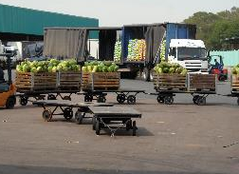
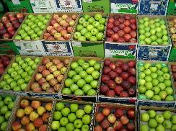
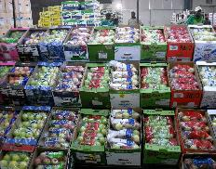
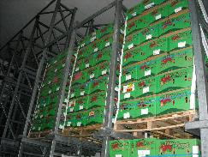
Facts about packaging in food chains
There are different types of packaging for different purposes
Pro’s | Con’s
Provides for food safety and hygiene during handling in the supply chain | Product quality is judged by consumers perceptions of the packaging
Protects products from damage | Excessive packaging contributes to packaging waste
Enable easy distribution (liquids) | Changes in packaging sometimes confuse consumers
Helps to display food | Packaging also contributes to food waste
Inform consumers (labelling)
Extends shelf life of some products

Slide 4
Impacts of packaging on food waste
Positive – extended shelf life
  Cucumber - plastic wrap prolongs shelf life from 3 to 14 days
  Broccoli – active packaging film prolong life by 20 days
  Gluten free bread – modified atmosphere prolong shelf life
Negative – contributes to food waste
  Packages too big or too small
  Packaging difficult to empty
  Incorrect use of packaging
  Misinterpretation of date labels i.e. “Best before date” printed on packaging
  Packaging failures

Slide 5
Global Action on Food Loss and Waste
The issue:
700 million people is living with hunger (UN World Food Program)
  1 out of every 11 people
Growing world population requires more food to be produced
Globally 30% of all food produced is lost or wasted
6% of global GHG emissions is from food waste
The solution: SDG 12.3
TARGET 12.3
By 2030, halve per capita global food waste at the retail and consumer levels and reduce food losses along production and supply chains, including post-harvest losses.

Slide 6
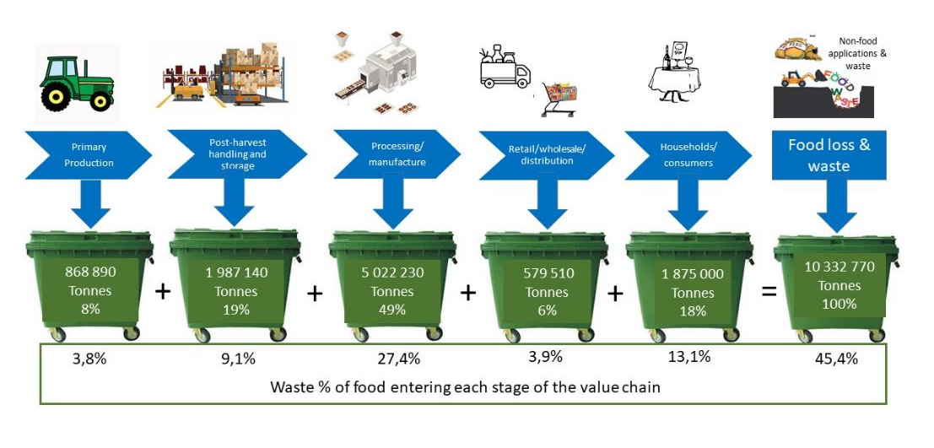
Food loss and waste estimate - 2021

Slide 7
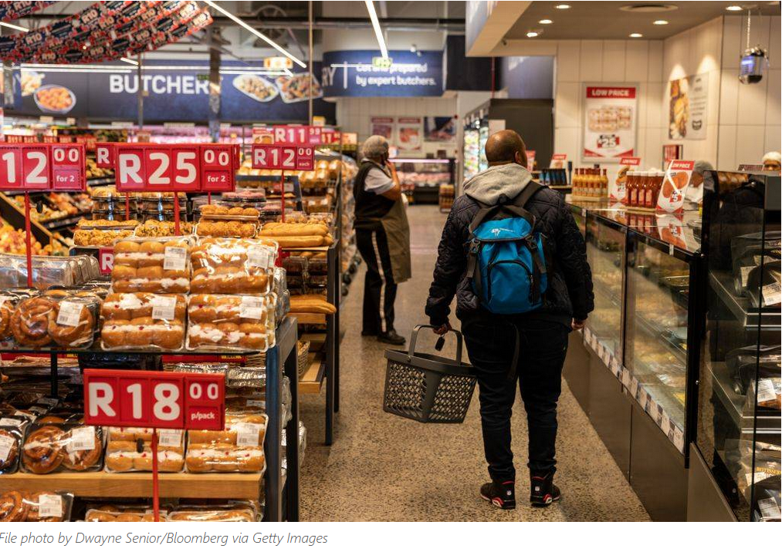
Cost of food waste in South Africa
20% (1 in 5) households in SA are food insecure
R61.5 billion/annum = cost of food waste along the value chain (Nahman & De Lange 2013)
R 5 155.34 = average cost of a household food basket in Sept 2023 (PMBEJDG)
R61.5 billion = 11.9 million food baskets

Slide 8
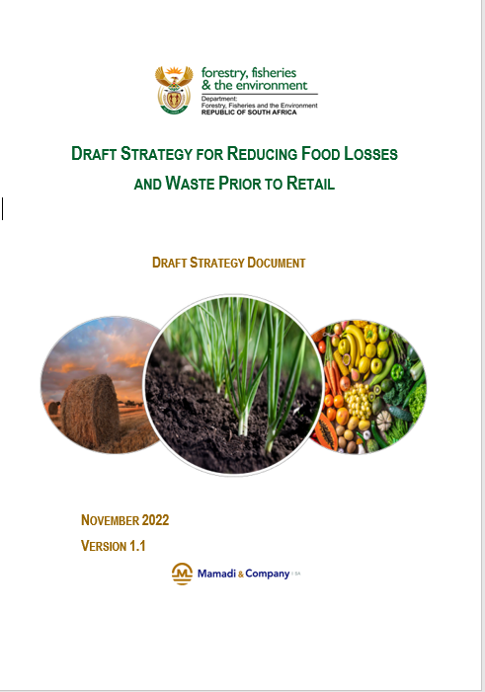
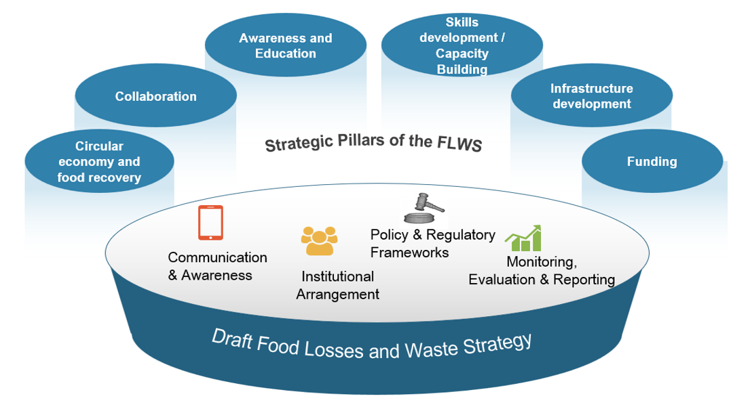
Strategy to reduce FLW

Slide 9
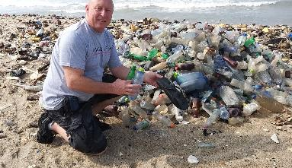
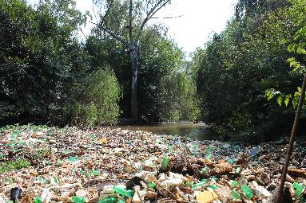
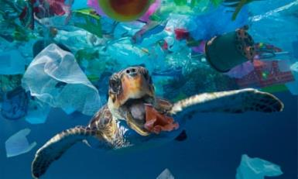
Global Action on Plastics
The issue:
Plastic is increasingly found in places it does not belong
  World seas and rivers
  Remote places including islands, high mountain peaks and in arctic snow
  Stomachs of wildlife, birds and fish
  Human stools and placentas
  Human blood samples
The Solution:
Negotiations are underway to develop a Global Treaty on plastic pollution by 2024

Slide 10
Municipal Solid Waste (MSW) (by weight) in South Africa
23.1 million tonnes MSW generated in 2017
>80% of all waste is disposed to land
37% are Mainline Recyclables (Paper, plastics, glass, metals)
17% is food waste

Slide 11
Value of waste in South Africa
Estimated resource value of the waste is R25.2billion per annum (0.86% of GDP in 2014)
  Recycling at ±10% (as at 2011 baseline) unlocked R8.2 billion/year worth of resources into the South African economy
  There is potential to recover a further R17 billion per annum worth of resources back into the economy
  R10 300 is the monthly living wage for a family in SA
  R17 billion can pay a monthly living wage to 137 540 families

Slide 12
South African Strategy to reduce plastic pollution

Slide 13
What does this mean for future food chains?
South African Consumers’ choice of packaging is guided by:
  Fitness for purpose
  Recyclability
  Information
  Attractiveness
  Quality
  Hygiene
Producers’, brand owners’ choice of packaging should be guided by:
  Fitness for purpose
  Protection of food throughout the value chain
  Environmental sustainability of packaging materials throughout the full life cycle

Slide 14
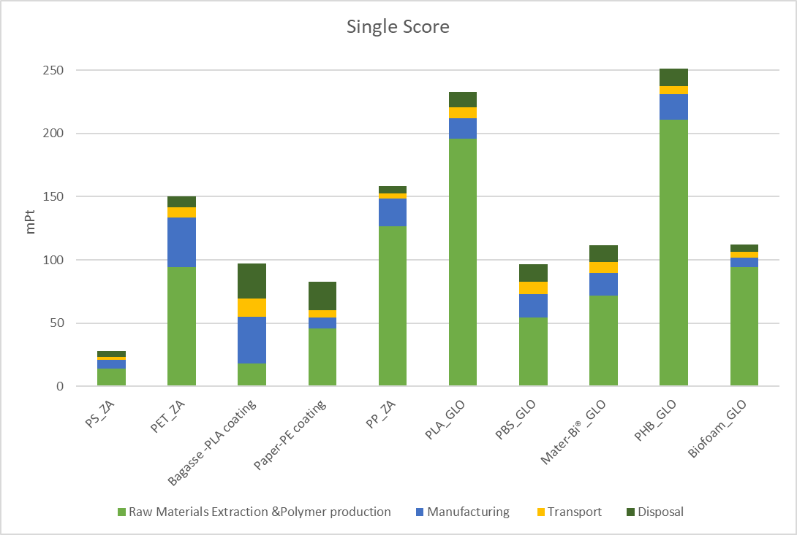
Material substitution – Polystyrene Take-out container E-LCA
Polystyrene has the lowest overall impacts when compared to alternative materials
But
E-LCA assumes proper end of life management

Slide 15
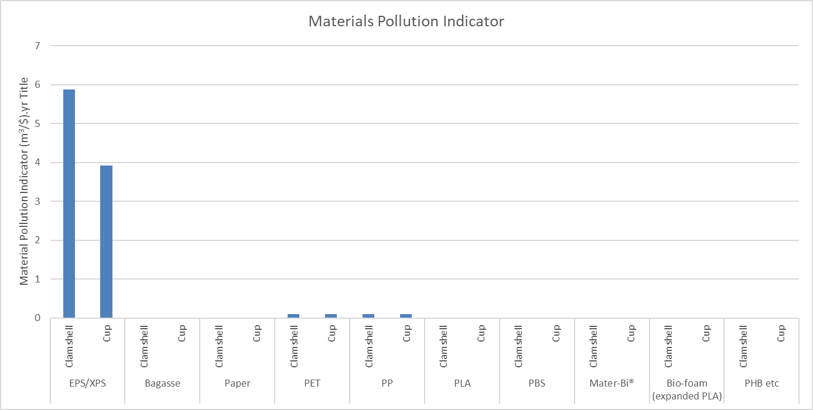
Material substitution – Polystyrene Take-out container MPI
Polystyrene has the highest environmental impacts if not collected and properly managed

Slide 16
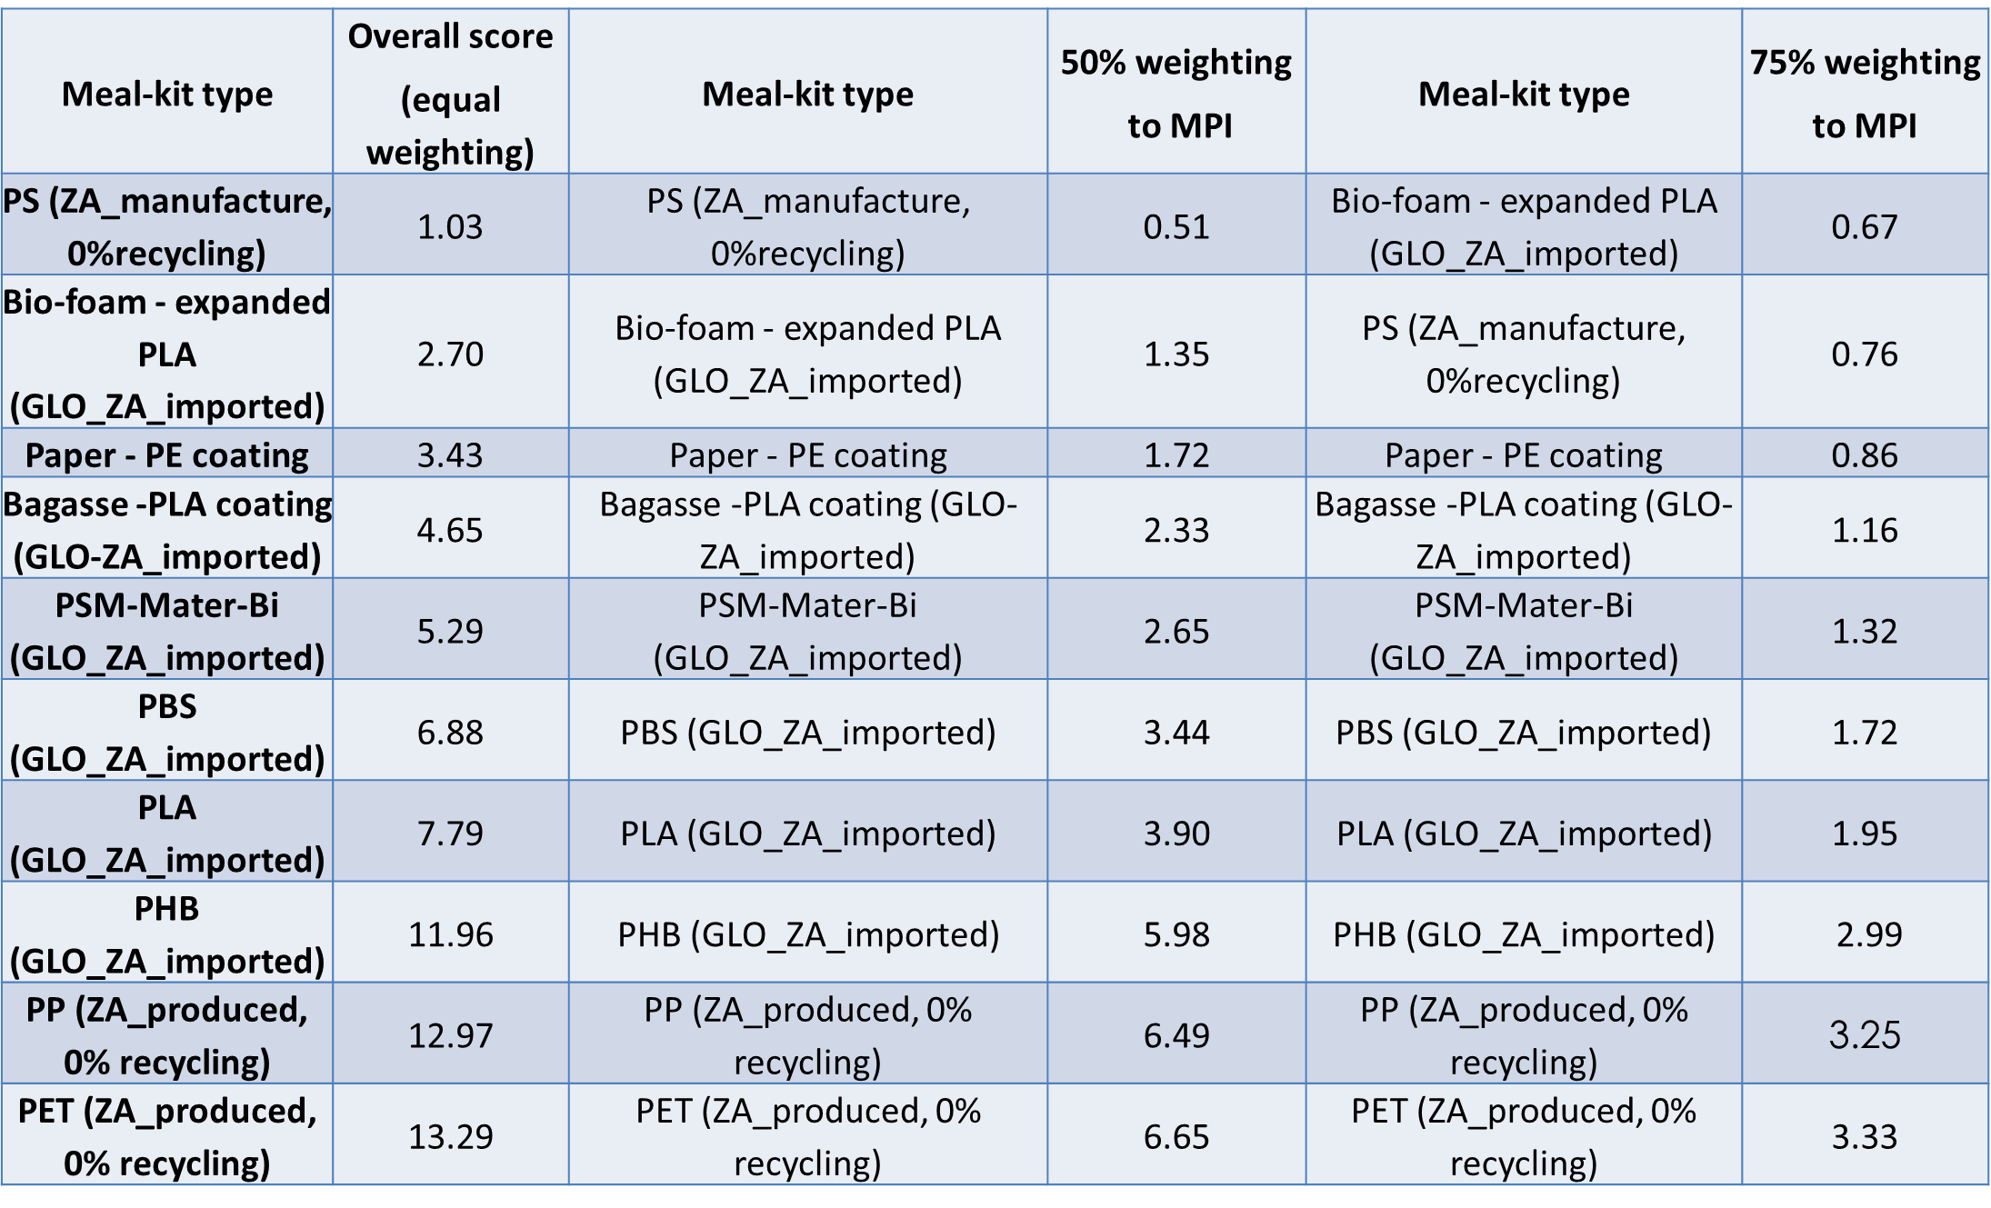
Which substitution option to choose?
MPI – Material Pollution Indicator

Slide 17
When is material substitution an option and what option to choose?
It will depend on the type of plastic and the weighting assigned to material pollution, for polystyrene takeaway containers, if:
75% of weighting is assigned to MPI
Bio-foam (as second lightweight option) being preferable
Also note that
Transitioning from PS to compostable alternatives can significantly reduce plastic pollution and the associated impacts if appropriately managed
BUT…
Caution should be applied to avoid a shifting of the environmental burdens to other areas of concerns

Slide 18
Conclusions
Balance between food waste and packaging waste is required
Environmental impact of food waste is higher than packaging waste
Packaging could play a significant role in food waste reduction if:
  Fit for purpose
  Easy to reseal
  Easy to open
  Packaging size is appropriate
  Easy to empty
  Relevant information on portion sizes, preparation, storage etc. is provided on pack
  Date labelling is easy to understand and interpret
Careful consideration is required when choosing a packaging option to ensure overall sustainability of the food chain

Slide 19
Thank you
Soelofse@csir.co.za www.csir.co.za

